Slide 1
WH:LG Reporting Process
OFFICIAL : SENSITIVE
May 2025
Please note that this DESNZ-led session is being recorded and will be made publicly available.

Slide 2
Aim of session
To understand how to access the online Data Management System within the DESNZ Warm Homes Grant Recipient Portal.
To understand how to submit your monthly report using the Data Management System, including looking at required information on:
  Project Activity
  Baselines
  Forecasts & Actuals
  Housing Data
  Financial Data
To understand how to raise a support request if you have a technical query or issue.
Please note that the portal is only available to GRs who have signed and returned their MoU and NDA.

Slide 3
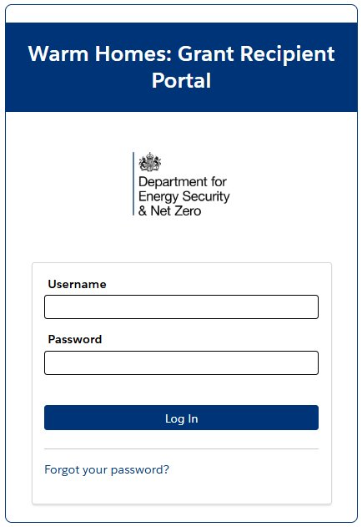
Data Management System Introduction
The Data Management System is part of the online Grant Recipient Portal for Grant Recipients to provide project updates to DESNZ.
The Data Management System is where monthly reporting data is captured.
You will be able to add information on progress to date, future planning, homes validated, assessed and completed.
The deadline for monthly reporting is the 10th working day of the month.
The monthly reporting burden has been reduced with information on addresses, measures, Trustmark data, costs, fraud and risk removed from the monthly report cycle. This information can be added to the portal as and when it is available.

Slide 4
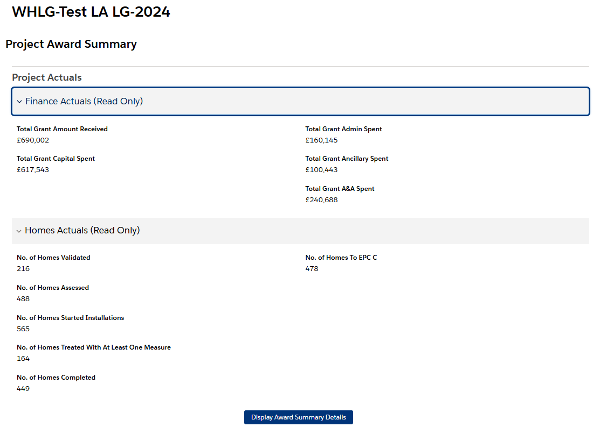
Project Summary
The Project Summary page displays high level detail on reported data
This information updates as monthly reports are submitted

Slide 5
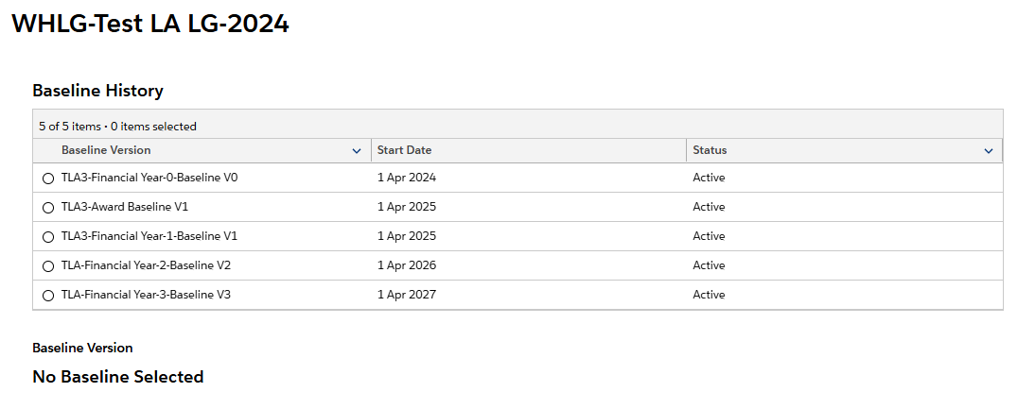
Baselines
Baseline data is derived from the Expression of Interest forms and scaled funding exercise completed by GRs and DESNZ respectively
This data is not editable in the portal and can only be amended as part of an approved Change Request

Slide 6
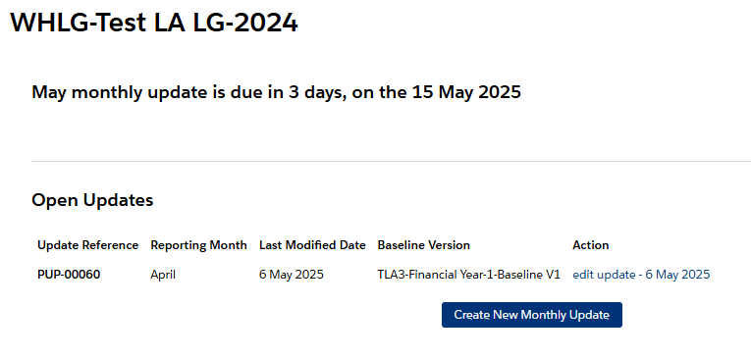
Monthly Updates
The Monthly Update section details when the next monthly report is due
It allows Grant Recipients to review and edit reports in progress
It also allows GRs to review previously submitted monthly reports

Slide 7
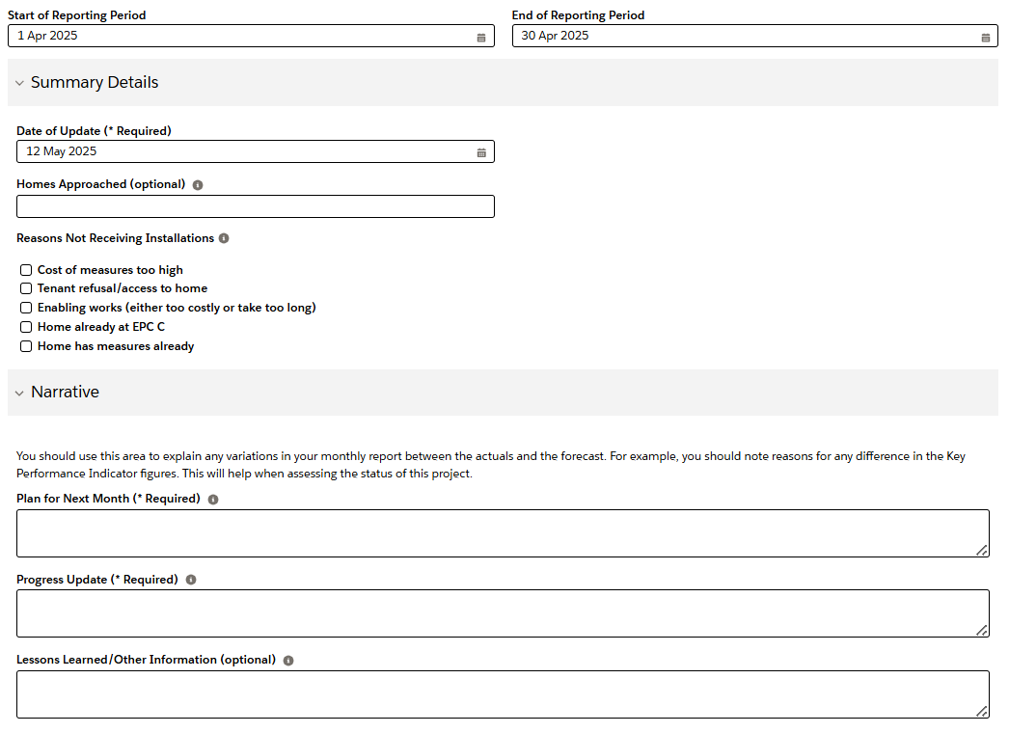
Monthly Updates
This is the first page of the monthly reporting template
This section allows Grant Recipients to report on homes approached and any issues being experienced
It also allows for a detailed update on progress to date, future plans for the project and any other information you think DESNZ should be aware of

Slide 8
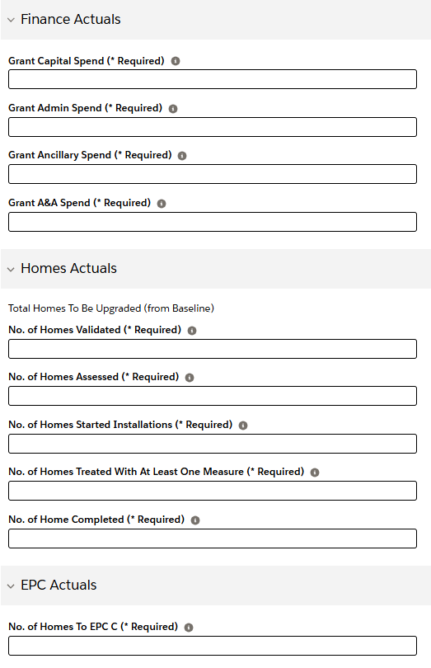
Monthly Updates
This is the second page of the monthly reporting template
This section is focussed on capital, admin and ancillary spend.
It also provides an opportunity to report on homes validated, assessed, in progress and completed
You are also able to report on homes to EPC C

Slide 9
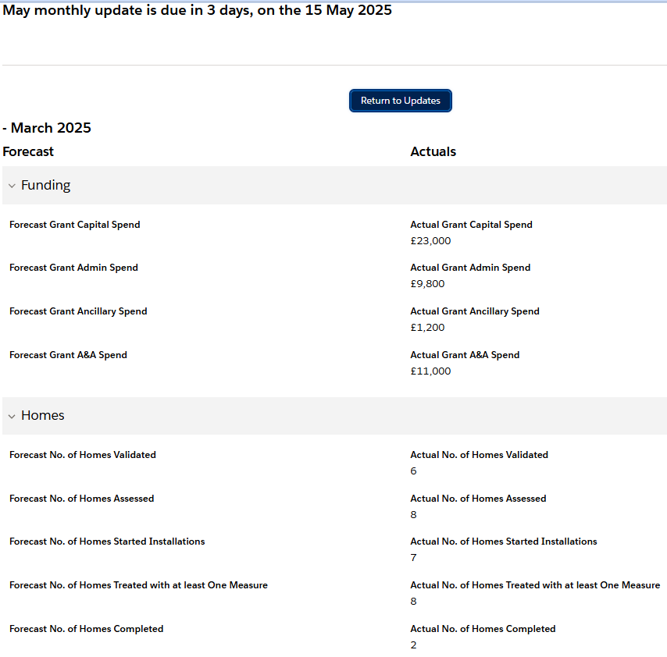
Forecasts vs Actuals
The DMS provides an opportunity to assess forecast data against actuals achieved
This should help facilitate monthly conversations with Project Support Officers (PSOs) on project progress to date

Slide 10
Raising a Support Request
For general queries about the portal and to raise a support request please email whlg@energysecurity.gov.uk in the first instance.
If we cannot resolve directly, we will escalate your case to our Support Team who will triage your request based on severity and assign an owner.
You will then receive a confirmation email with a unique ticket number.
The email subject line will automatically be attached to the ticket subject, and any further communications will be logged against the respective ticket.
Case owners may request more details if needed and the case may be escalated for further action.

Slide 11
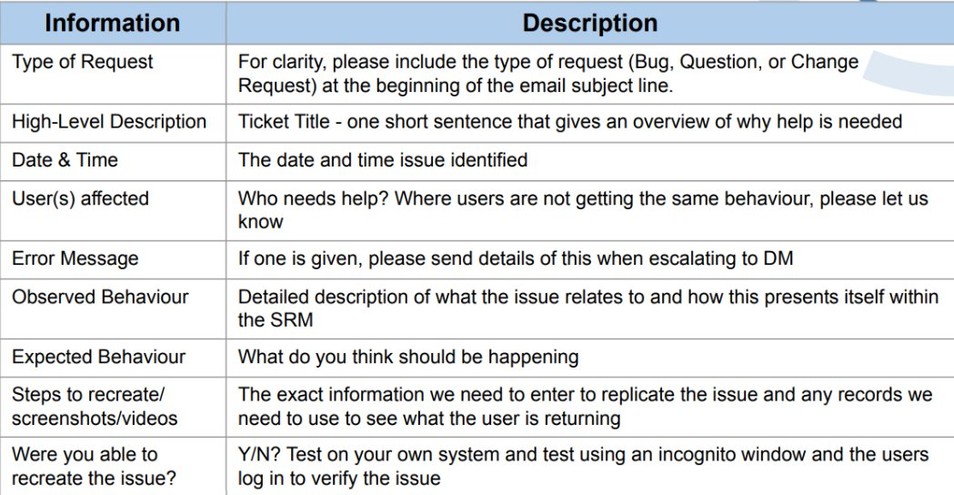
Information required for a Support Request
Please ensure that you provide the information outlined below to help us identify and resolve the issue as quickly as possible:

Slide 12
Submitting your first monthly report
You must submit all reports through the Grant Recipient Portal using the data that is available to you.
Your monthly report is due by the 10th working day of each month.
However, due to the timing of your onboarding and training onto the Grant Recipient Portal, the first reporting deadline to report April’s activities has been extended to Thursday 29th May. This is to allow time for you to complete your training and onboarding.
DESNZ has set this date at 10 working days after the Reporting Process Webinar has taken place to replicate the usual reporting process timeline.

Slide 13
Additional Sessions and Feedback
WH:LG Batch Submission Process webinar – Thursday 15th May
Grant Recipient Portal drop-in sessions - Wednesday 4th June & Wednesday 11th June, 11am – 12pm
If you would like to provide further feedback on the portal, please email whlg@energysecurity.gov.uk.

